Slide 1
Sorting
Dr. Jonathan Phillips
Utah State University

Slide 2
Sorting – Definition
Given a random sequence of data items (generally stored in an array or list style container), we want to reorder the items in increasing (or decreasing) order
7
4
3
8
10
1
2
8
1
2
3
4
7
8
8
10

Slide 3
Sorting – Useful?
Ordered data is critical for maintaining databases and other list-type sequences where we want to efficiently search for items
Example: Is there a 5 in the data below?
7
4
3
8
10
1
2
8
1
2
3
4
7
8
8
10

Slide 4
Sorting – Strategies
Critical field in Computer Science
Hundreds of sorting algorithms exist, with various efficiencies in both time and space
We will explore some of the most common, including
Bubble Sort
Selection Sort
Insertion Sort
Quick Sort

Slide 5
Algorithm Complexity – “Big O notation”
Used to represent rough orders of complexity (or estimate of number of computations) for different algorithms
Typically written as O(log2n), O(n), O(n * log₂n), O(n²), etc.
n represents the number of items in our container
Algorithm complexity does not matter much for small n
However, for large n, complexity becomes very important
n | O(log n) | O(n) | O(n * log n) | O(n²) | O(n³)
10 | 3.32 | 10 | 33.22 | 100 | 1,000
100 | 6.64 | 100 | 664.34 | 10,000 | 1,000,000
1,000 | 9.97 | 1,000 | 9965.8 | 1,000,000 | 1,000,000,000
10,000 | 13.29 | 10,000 | 132,877 | 100,000,000 | 1,000,000,000,000
100,000 | 16.61 | 100,000 | 1,660,964 | 10,000,000,000 | 1,000,000,000,000,000

Slide 6
Bubble Sort
Summary
Step through the list, compare adjacent elements, swap if needed
Repeat until an entire pass through the list results in zero swaps
Algorithm
procedure bubbleSort( A : list of sortable items )
n = length(A)
repeat
swapped = false
for i = 1 to n-1 inclusive do
if A[i-1] > A[i] then
swap( A[i-1], A[i] )
swapped = true
end if
end for
until not swapped
end procedure

Slide 7
Bubble Sort
Example
By Swfung8 [CC BY-SA 3.0 (https://creativecommons.org/licenses/by-sa/3.0) or GFDL (http://www.gnu.org/copyleft/fdl.html)], from Wikimedia Commons

Slide 8
Bubble Sort
Complexity
There are n elements in the list

Slide 9
Bubble Sort
Complexity
There are n elements in the list
We traverse the list at worst n-1 times to get everything sorted

Slide 10
Bubble Sort
Complexity
There are n elements in the list
We traverse the list at worst (n-1) times to get everything sorted
n * (n-1) ≈ n²
Bubble sort is an O(n²) algorithm
Does it have any advantages?
https://en.wikipedia.org/wiki/Bubble_sort

Slide 11
Selection Sort
Summary
Builds the sorted list (in place) one item at a time by identifying the smallest remaining unsorted item and swapping it with the first unsorted item
Algorithm
for (j = 0; j < n-1; j++) {
iMin = j;
for (i = j+1; i < n; i++) {
if (a[i] < a[iMin]) {
iMin = i;
}
}
if (iMin != j) {
swap(a[j], a[iMin]);
}
}

Slide 12
Selection Sort
Example
Joestape89 at the English language Wikipedia [GFDL (http://www.gnu.org/copyleft/fdl.html) or CC-BY-SA-3.0 (http://creativecommons.org/licenses/by-sa/3.0/)], via Wikimedia Commons

Slide 13
Selection Sort
Complexity
There are n elements in the list

Slide 14
Selection Sort
Complexity
There are n elements in the list
We traverse the list at worst n-1 times to get everything sorted

Slide 15
Selection Sort
Complexity
There are n elements in the list
We traverse the list at worst (n-1) times to get everything sorted
n * (n-1) ≈ n²
Selection sort is an O(n²) algorithm
Does it have any advantages?
https://en.wikipedia.org/wiki/Selection_sort

Slide 16
Insertion Sort
Summary
Builds the sorted list (in place) one item at a time
Algorithm
i = 1
while i < length(A)
j = i
while j > 0 and A[j-1] > A[j]
swap A[j] and A[j-1]
j = j - 1
end while
i = i + 1
end while

Slide 17
Insertion Sort
Example
By Swfung8 [CC BY-SA 3.0 (https://creativecommons.org/licenses/by-sa/3.0) or GFDL (http://www.gnu.org/copyleft/fdl.html)], from Wikimedia Commons

Slide 18
Insertion Sort
Complexity
There are n elements in the list

Slide 19
Insertion Sort
Complexity
There are n elements in the list
We traverse the list at worst n-1 times to get everything sorted

Slide 20
Insertion Sort
Complexity
There are n elements in the list
We traverse the list at worst (n-1) times to get everything sorted
n * (n-1) ≈ n²
Insertion sort is an O(n²) algorithm
Does it have any advantages?
https://en.wikipedia.org/wiki/Insertion_sort

Slide 21
Quicksort
Summary
Pick a pivot element from the array
Partition the array such that everything less than the pivot is before it; everything greater than the pivot is after; the pivot element is in its final location
Recursively apply the same algorithm to each sub-array

Slide 22
Quicksort
Algorithm
algorithm quicksort(A, lo, hi) is
if lo < hi then
p = partition(A, lo, hi)
quicksort(A, lo, p - 1 )
quicksort(A, p + 1, hi)
algorithm partition(A, lo, hi) is
pivot = A[hi]
i = lo - 1
for j = lo to hi - 1 do
if A[j] < pivot then
i = i + 1
swap A[i] with A[j]
swap A[i + 1] with A[hi]
return i + 1

Slide 23
The Quicksort Algorithm
Initially, low points to the first element; high points to the last.
We copy the first element (the partitioning element) into a temporary location, leaving a “hole” in the array.
Next, we move high across the array from right to left until it points to an element that’s smaller than the partitioning element.
We then copy the element into the hole that low points to, which creates a new hole (pointed to by high).
We now move low from left to right, looking for an element that’s larger than the partitioning element. When we find one, we copy it into the hole that high points to.
The process repeats until low and high meet at a hole.
Finally, we copy the partitioning element into the hole.

Slide 24
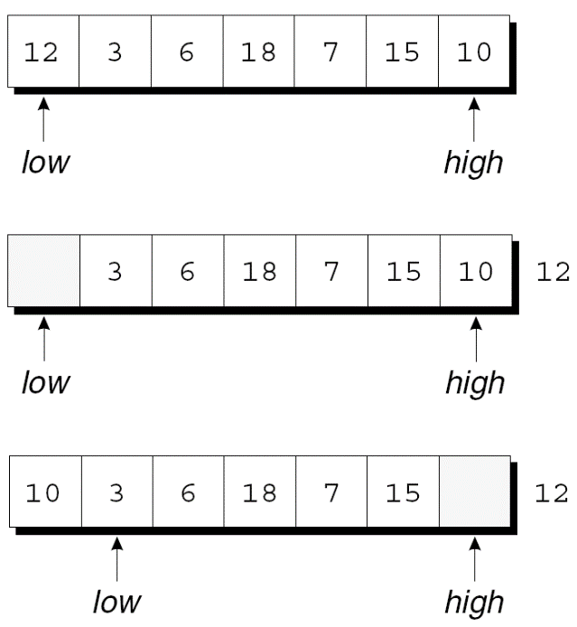
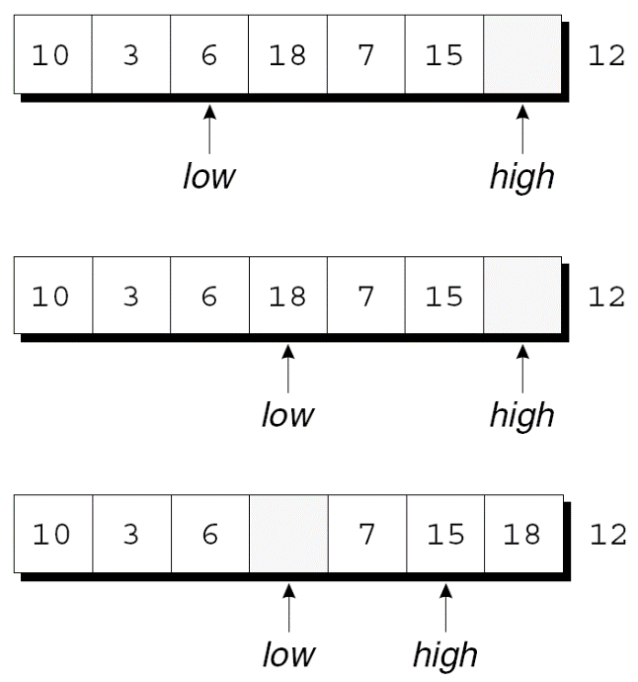
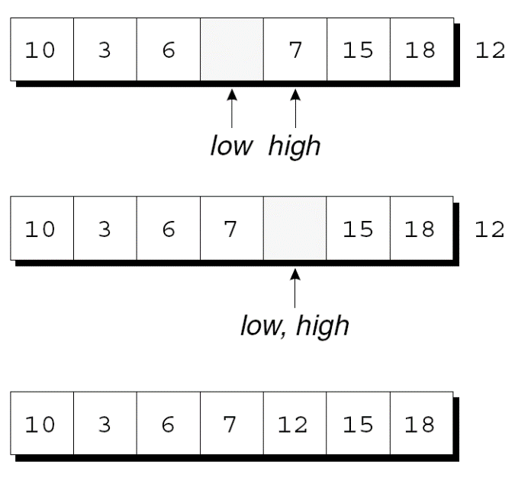
The Quicksort Algorithm
Example of partitioning an array:

Slide 25
Quicksort
Example
en:User:RolandH [GFDL (http://www.gnu.org/copyleft/fdl.html), CC-BY-SA-3.0 (http://creativecommons.org/licenses/by-sa/3.0/) or CC BY-SA 2.5-2.0-1.0 (https://creativecommons.org/licenses/by-sa/2.5-2.0-1.0)], via Wikimedia Commons

Slide 26
Quicksort
Complexity
There are n elements in the list
We traverse the list at worst log₂n times to get everything sorted
Quicksort is an O(n*logn) algorithm
Preferred sort for many applications
https://en.wikipedia.org/wiki/Quicksort

